Slide 1
Buzz Feeds.AI
News on Reel, Powered by AI

Slide 2
Problem Statement
Platforms like Instagram and TikTok, where the average user spends approximately 29 minutes daily watching reels, can contribute to decreased productivity and superficial engagement with content. This frequent consumption of often trivial material can detract from time spent on more meaningful or educational activities.

Slide 3
Agenda
Buzz Feeds leverages cutting-edge AI to curate and generate personalized news reels for users, providing an engaging platform where news consumption meets interactive technology. It prioritizes user-centric design and personalization, ensuring content relevance and fostering an interactive community around current events.

Slide 4
Tech Stack
Backend
Google Gemini 1.5 pro
Vertex AI
Dalle-3
Google Text To Speech (TTS)
Front End – Low Code framework
Streamlit

Slide 5
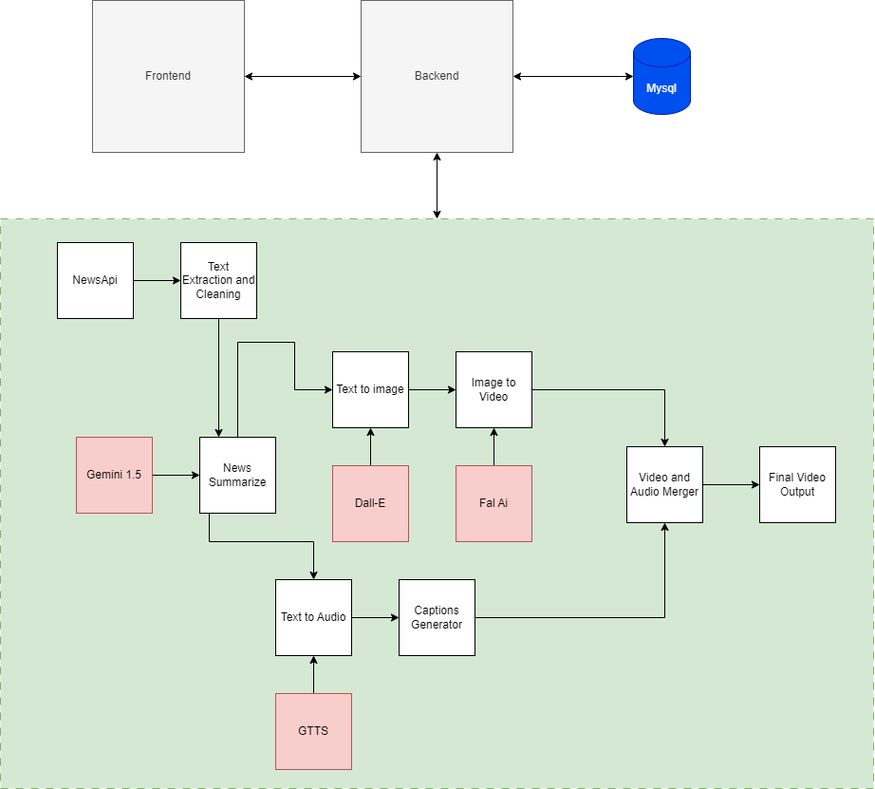
Work-Flow

Slide 6
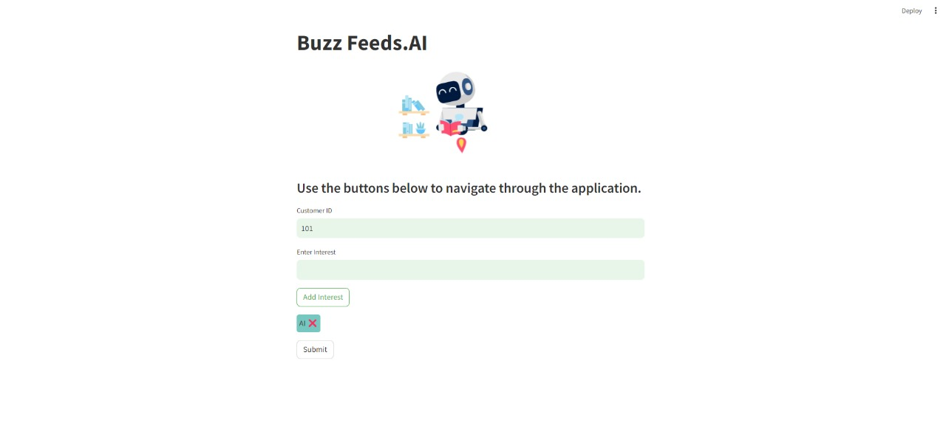
Demo

Slide 7
Thank you
Amith Ramaswamy
amithr707@gmail.com
Harshith Deshalli Ravi
harshithdr10@gmail.com

